Slide 1
Chapter 2 Data Models
Compiled by Yaynshet. M

Slide 2
Data Model
The Database model in the DBMS explains
The logic behind the structure of a Database system that should usually include
All the tables, which are represented as entities in ER model,
The relationships between the tables and objects, and
The requirement provided by the project team in order to settle on how data can be stored & accessed, granted
Data Model: higher-level language with sets of concepts to describe the structure of a database, and certain constraints that the database should obey
A data model is a description of the way that data is stored in a database

Slide 3
Data model
Generally it is a collection of tools or concepts for describing
Data
Data relationships
Data semantics
Data constraints
Concepts to represent the data in an understandable way
Some of the different Data Models
Hierarchical Data Model
Network Data Model
Relational Data Model

Slide 4
Hierarchical Model
The hierarchical model is based on the parent-child hierarchical relationship.
In this model, there is one parent entity with several children entity.
A parent node can have more than one child node
A child node can only have one parent node
The relationship between parent and child is one-to-many
At the top, there should be only one entity which is called root.
Nodes are arranged in a hierarchical structure as sort of upside-down tree
To add new record type or relationship, the database must be redefined and then stored in a new form
For example, an organization is the parent entity called root and it has several children entities like clerk, officer, and many more.
Top-down way of viewing business entities.

Slide 5
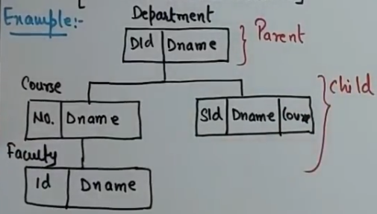
Hierarchical data model

Slide 6
ADVANTAGES Hierarchical Model
Clear Chain of Command
Members know to whom they report and who reports to them.
Communication gets channeled along defined and predictable paths,
which allows those higher in the organization to direct questions to the appropriate parties.
Individuals tend to know who does and does not possess the authority to assign or change tasks
Clear Paths of Advancement
Hierarchical structures offer very clear, if not always easy, advancement paths.
Specialization
The hierarchical structure divides larger tasks and areas of concern into various department configurations that specialize.
Specialization allows organizations to concentrate particular skill sets and resources to achieve maximum efficiency.

Slide 7
DISADVANTAGES Hierarchical Model
Poor Flexibility
Hierarchical structures tend to adapt slowly to changing needs.
Communication Barriers
As hierarchical organizational structures tend to channel communication vertically, interdepartmental or inter-agency communication suffers.
Departmental specialization can lead to communication barriers when no shared jargon exists that allows members of different departments to communicate on the same level.
Organizational Disunity
The departmentalizing of specializations leads, in some cases, to decisions made to benefit a department rather than the organization goals.

Slide 8
Network Model
In the network data model, all the entities are organized in graphical representations.
There may be several parts in the graph in which the entities can be accessed.
Data is represented by collection of records
Relationships among data is represented by links
Record is a collection of attributes, each which contain only one data value.
The link is an association between two records
Allows record types to have more that one parent unlike hierarchical model
A network data models sees records as set members
Each set has an owner and one or more members
Like hierarchical model network model is a collection of physically linked records.
Allow member records to have more than one owner [multi-connection way of business entities]

Slide 9
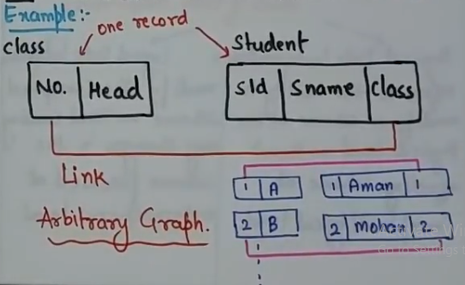
Network Model

Slide 10
ADVANTAGES of Network Data Model:
Some advantages include
conceptual simplicity
data access flexibility
conformance to standards
handle more relationship types
promote database integrity
allows for data independence.

Slide 11
DISADVANTAGES of Network Data Model:
The structure is difficult to change
This type of system is very complex
There is a lack of structural independence.
In summary the network database model is similar but different than the hierarchal database model.
But the network database model should be used when it is necessary to have a flexible way of representing objects and their relationships.

Slide 12
Relational Data Model
The most popular and extensively used data model is the relational data model.
The data model allows the data to be stored in tables called a relation.
The relations are normalized and the normalized relation values are known as atomic values.
Each of the rows in a relation is called tuples which contains the unique value.
A row of the table is called tuple => equivalent to record
The attributes are the values in each of the columns which are of the same domain.
A column of a table is called attribute => equivalent to fields
Can define more flexible and complex relationship

Slide 13
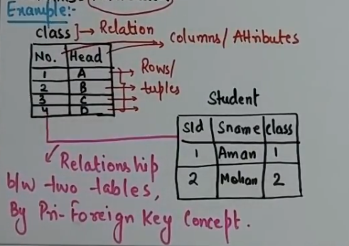
Relational model
The tables seem to be independent but are related some how
No physical consideration of the storage is required by the user
Many tables are merged together to come up with a new virtual view of the relationship
Alternative terminologies
Relation=Table = File
Tuple = Row = Record
Attribute = Column = Field

Slide 14
Relational model
The rows represent records (collections of information about separate items)
The columns represent fields (particular attributes of a record)
Conducts searches by using data in specified columns of one table to find additional data in another table
In conducting searches, a relational database matches information from a field in one table with information in a corresponding field of another table to produce a third table that combines requested data from both tables

Slide 15
Properties of Relational model
Each row of a table is uniquely identified by a PRIMARY KEY composed of one or more columns
Each tuple in a relation must be unique
Group of columns, that uniquely identifies a row in a table is called a CANDIDATE KEY
ENTITY INTEGRITY RULE of the model states that no component of the primary key may contain a NULL value.
A column or combination of columns that matches the primary key of another table is called a FOREIGN KEY.
Foreign key is Used to cross-reference tables.

Slide 16
Properties of Relational model
The REFERENTIAL INTEGRITY RULE of the model states that, for every foreign key value in a table there must be a corresponding primary key value in another table in the database or it should be NULL.
All tables are LOGICAL ENTITIES
A table is either a BASE TABLES (Named Relations) or VIEWS (Unnamed Relations)
Only Base Tables are physically stored
VIEWS are derived from BASE TABLES with SQL instructions like: [SELECT .. FROM .. WHERE .. ORDER BY]

Slide 17
Properties of Relational model
Order of rows and columns is immaterial
Entries with repeating groups are said to be un-normalized
Entries are single-valued
Each column (field or attribute) has a distinct name
NB: All values in a column represent the same attribute and have the same data format

Slide 18
Building Blocks of Relational Model
The building blocks of the relational data model are:
Entities: real world physical or logical object
Attributes: properties used to describe each Entity or real world object.
Relationship: the association between Entities
Constraints: rules that should be obeyed while manipulating the data

Slide 19
Building blocks of Relational Model
ENTITIES
persons, places, things etc. which the organization has to deal with.
The name given to an entity should always be a singular noun descriptive of each item to be stored in it.
E.g.: student NOT students

Slide 20
Building blocks of Relational Model
Every relation has a schema, which describes the columns, or fields and the relation itself
Existence Dependency: the dependence of an entity on the existence of one or more entities.
Weak entity: an entity that cannot exist without the entity with which it has a relationship

Slide 21
Building blocks of Relational Model
2. ATTRIBUTES –
the items of information which characterize and describe these entities.
Attributes are pieces of information ABOUT entities

Slide 22
Building blocks of Relational Model
At this level we need to know such things as:
Attribute name (be explanatory words or phrases)
The domain from which attribute values are taken
(A DOMAIN is a set of values from which attribute values may be taken.)
Each attribute has values taken from a domain
For example, the domain of Name is string and that for salary is real
Whether the attribute is part of the entity identifier (attributes which just describe an entity and those which help to identify it uniquely)
Whether it is permanent or time-varying (which attributes may change their values over time)
Whether it is required or optional for the entity (whose values will sometimes be unknown or irrelevant)

Slide 23
Building blocks…Types of Attributes
(1)Simple (atomic) Vs Composite attributes
Simple: contains a single value (not divided into sub parts)
E.g. Age, gender
Composite: Divided into sub parts (composed of other attributes)
E.g. Name, address
(2)Single-valued Vs multi-valued attributes
Single-valued : have only single value(the value may change but has only one value at one time)
E.g. Name, Sex, Id. No., color_of_eyes
Multi-Valued: have more than one value
E.g. Address, dependent-name Person may have several college degrees, several languages

Slide 24
Building blocks… Types of Attributes
(3)Stored vs. Derived Attribute
Stored : not possible to derive or compute
E.g. Name, Address
Derived: The value may be derived (computed) from the values of other attributes.
E.g. :
Age (current year – year of birth
Length of employment (current date- start date)
Profit (earning-cost)
G.P.A (grade point/credit hours)
(4) Null Values
• NULL applies to attributes which are not applicable or which do not have values.
• You may enter the value NA (meaning not applicable)
NB: Value of a key attribute cannot be null.
Default value – is the value assumed value if no explicit value

Slide 25
Building blocks of Relational Model
3. RELATIONSHIP
In any business processing one object may be associated with another object due to some event.
Such kind of association is what we call a RELATIONSHIP between entity objects.
Related entities require setting of LINKS from one part of the database to another.
A relationship should be named by a word or phrase which explains its function

Slide 26
Degree of relationship
An important point about a relationship is how many entities participate in it.
The number of entities participating in a relationship is called the DEGREE of the relationship.
UNARY/RECURSIVE RELATIONSHIP: Tuples/records of a Single entity are related with each other.
BINARY RELATIONSHIPS: Tuples/records of two entities are associated in a relationship
TERNARY RELATIONSHIP: Tuples/records of three different entities are associated
And a generalized one:
N-NARY RELATIONSHIP: Tuples from arbitrary number of entity sets are participating in a relationship

Slide 27
Cardinality of a Relationship
The number of instances participating or associated with a single instance from an entity in a relationship is called the CARDINALITY of the relationship.
ONE-TO-ONE: one tuple is associated with only one other tuple.
E.g. Building – Location: - as a single building will be located in a single location and as a single location will only accommodate a single Building.

Slide 28
Cardinality of a Relationship
ONE-TO-MANY: one tuple can be associated with many other tuples, but not the reverse.
E.g. Department-Student: - as one department can have multiple students.
MANY-TO-ONE: many tuples are associated with one tuple but not the reverse.
E.g. Employee – Department: as many employees belong to a single department
MANY-TO-MANY: one tuple is associated with many other tuples and from the other side, with a different role name one tuple will be associated with many tuples
E.g. Student – Course: - as a student can take many courses and a single course can be attended by many students.

Slide 29
SQL Components
The Structured Query Language (SQL) is the set of instructions used to interact with a relational database.
In fact, SQL is the only language that most Relational databases understand.
Whenever you interact with such a database,
the software translates your commands (whether they are mouse clicks or form entries) into a SQL statement that the database knows how to interpret.

Slide 30
SQL Components
As a user of any database-driven software program, you’re probably using SQL, even if you don’t know it.
For example, a database-driven dynamic web page (like most websites)
takes user input from forms and clicks and
uses it to compose a SQL query that retrieves information from the database required to generate the next web page.

Slide 31
SQL Components
Consider the example of a simple online catalog with a search function.
The search page might consist of a form containing just a text box in which you enter a search term and then click a search button.
When you click the button,
the web server retrieves any records from the product database containing the search term and uses the results to create a web page specific to your request.

Slide 32
SQL Components
For example, if you searched for products containing the term "Irish,"
the server might use the following SQL statement to retrieve related products:
SELECT * FROM products WHERE name LIKE '%irish%’;
Translated, this command
retrieves any records from the database table named "products" that contain the characters "irish" anywhere within the product name.

Slide 33
SQL components
SQL has three main components:
The Data Manipulation Language (DML),
The Data Definition Language (DDL), and
The Data Control Language (DCL).

Slide 34
The Data Manipulation Language
The Data Manipulation Language (DML) contains the subset of SQL commands used most frequently
They simply manipulate the contents of a database in some form.
The four most common DML commands are
The SELECT command which is used to retrieve information from a database
The INSERT command used to add new information to a database
The UPDATE command which is used to modify information currently stored in a database
The DELETE command which is used to remove information from a database

Slide 35
Data Definition Language
The Data Definition Language (DDL) contains commands that are less frequently used.
DDL commands modify the actual structure of a database, rather than the database’s contents.
Examples of commonly used DDL commands include those used to
generate a new database table (CREATE TABLE),
modify the structure of a database table (ALTER TABLE), and
delete a database table (DROP TABLE).

Slide 36
Data Control Language
The Data Control Language (DCL) is used to manage user access to databases.
It consists of two commands:
the GRANT command, used to give database permissions for a user, and
the REVOKE command, used to remove existing permissions.
These two commands form the core of the relational database security model.

Slide 37
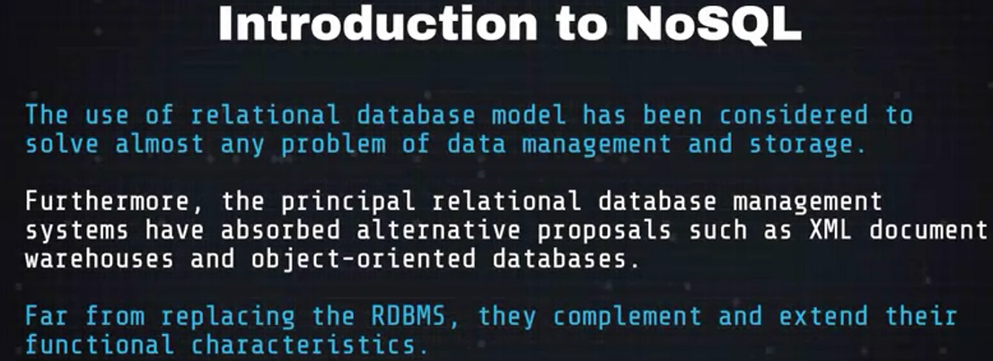
NOSQL Systems

Slide 38
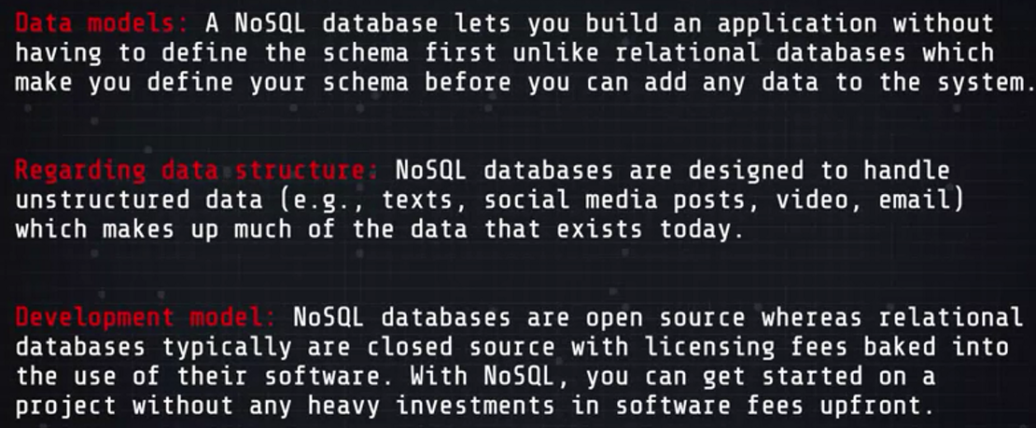
How NoSQL Differ from SQL

Slide 39
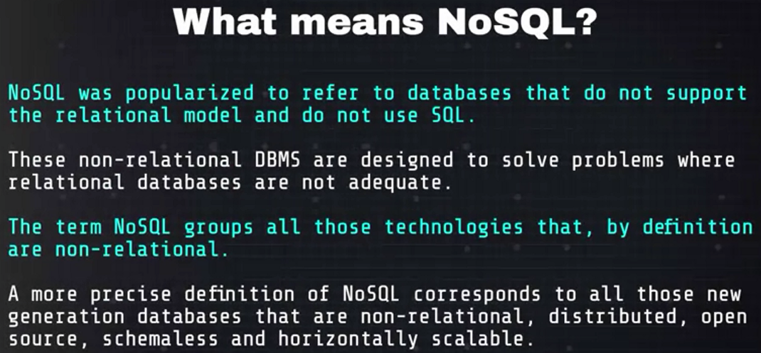
NoSQL?

Slide 40
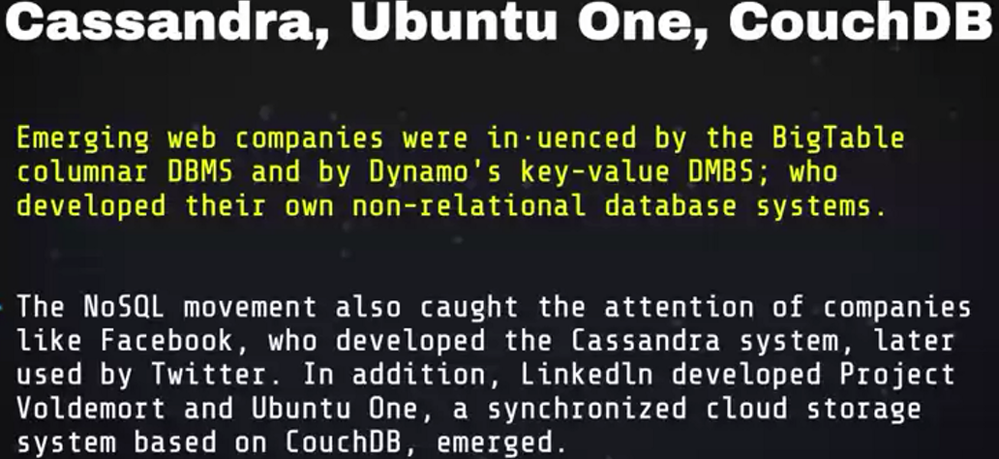
NoSQL

Slide 41
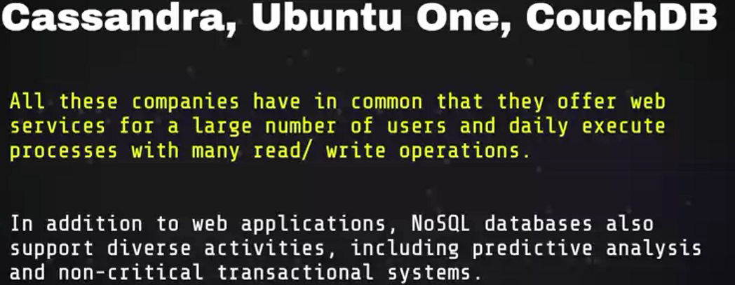
NoSQL

Slide 42
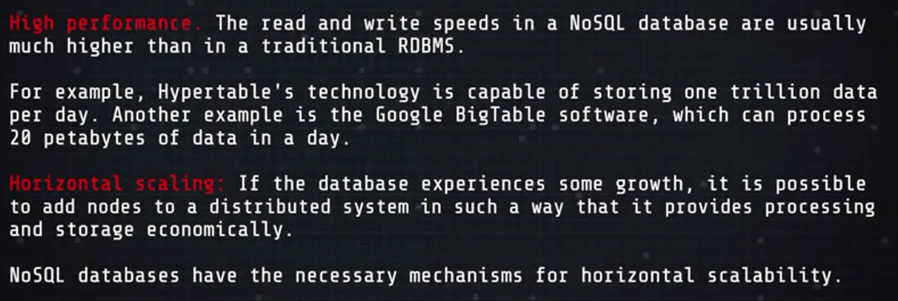
Advantages

Slide 43
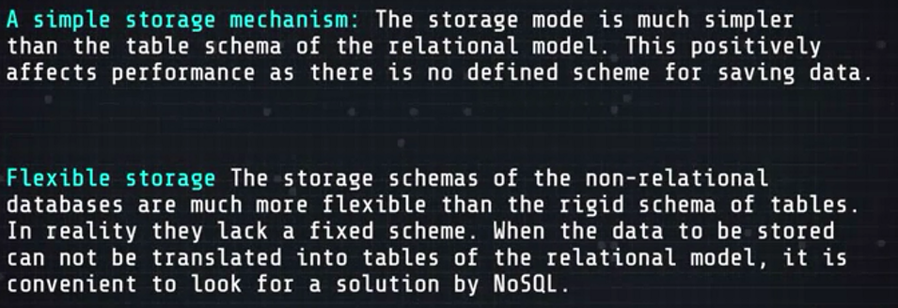
Advantages

Slide 44
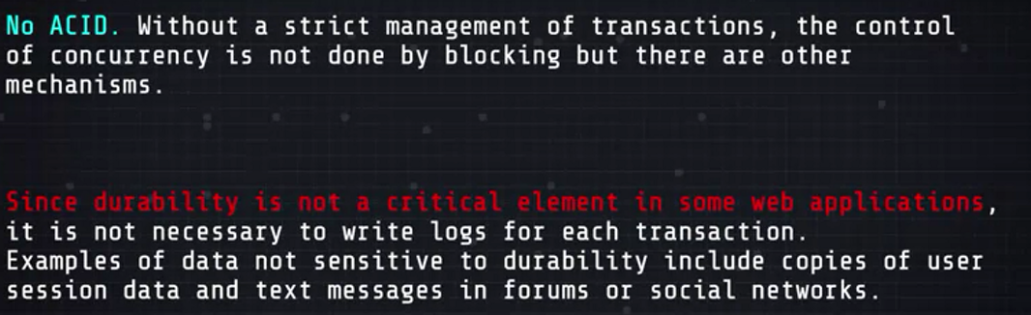
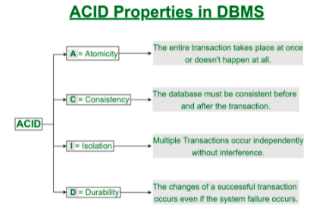
Advantages
A transaction is a single logical unit of work which accesses and possibly modifies the contents of a database.
Transactions access data using read and write operations.
In order to maintain consistency in a database, before and after the transaction, certain properties are followed. These are called ACID properties. ACID is very Fundamental
This is not to say that we can not do ACID with NoSQL because we can ,its not just built in to the core system at a level that it is with relational database is

Slide 45
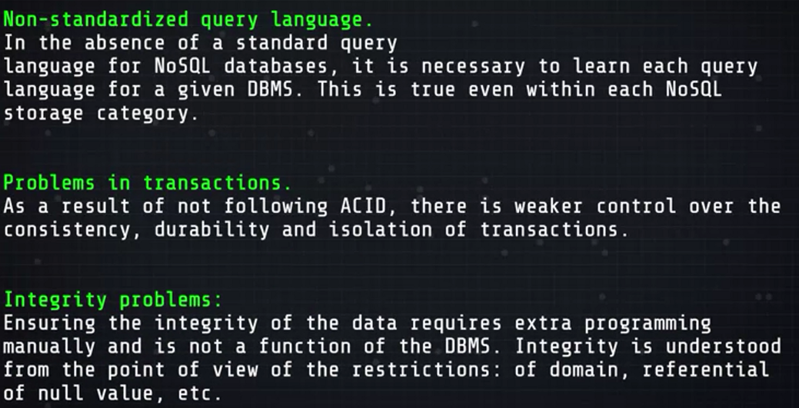
Disadvantages of NoSQL

Slide 46
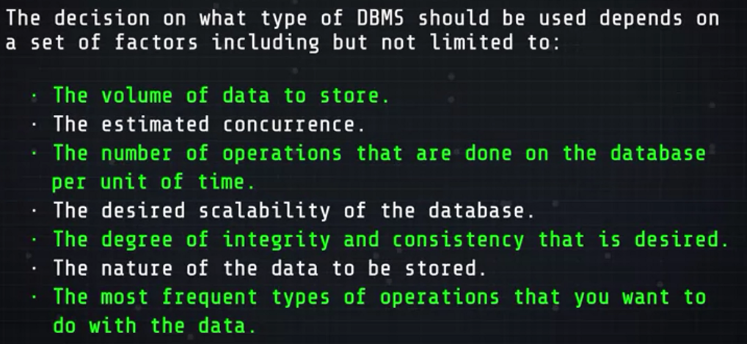
RDBMS or NRDBMS?

Slide 47
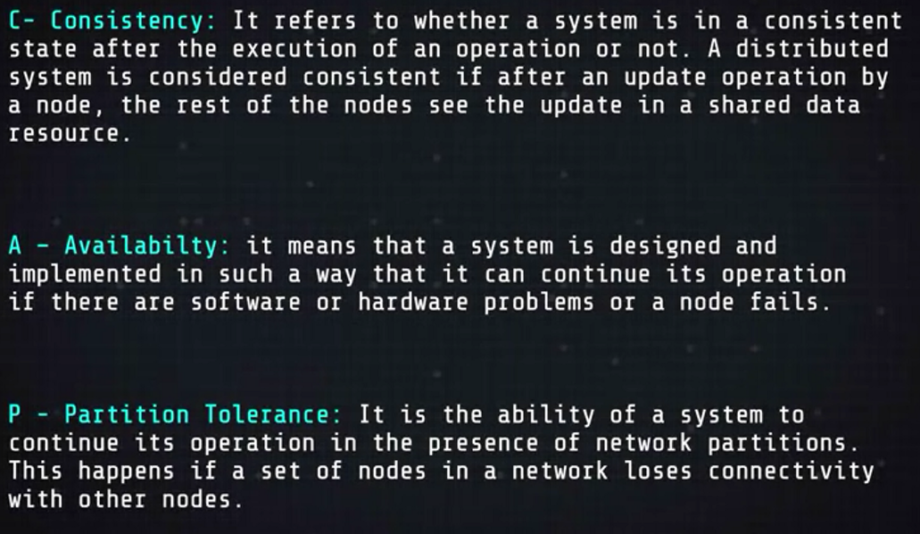
Characteristics of NoSQL Databases
Two characteristics of NoSQL Databases
CAP

Slide 48
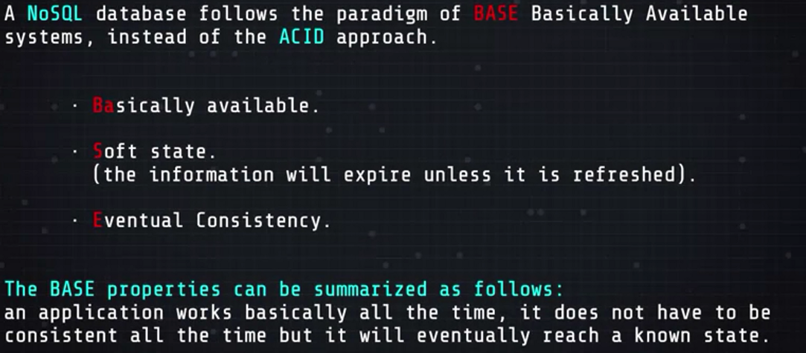
Characteristics of NoSQL Databases
2. BASE

Slide 49
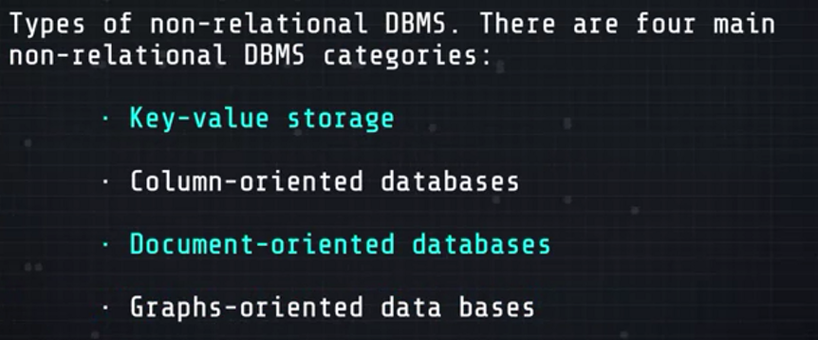
Types of NRDBMS

Slide 50
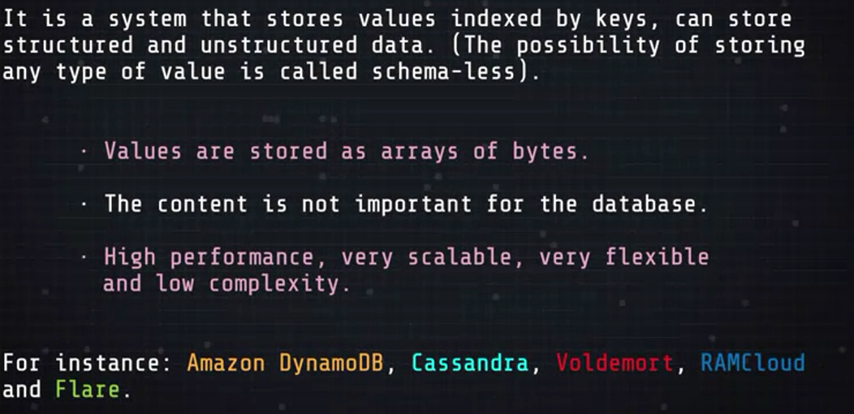
Key-Value database
Redis, Riak and Oracle NoSQL database are another examples of key-value databases.

Slide 51
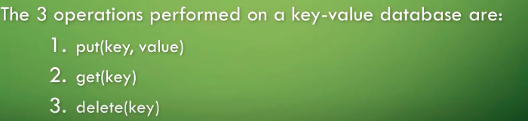
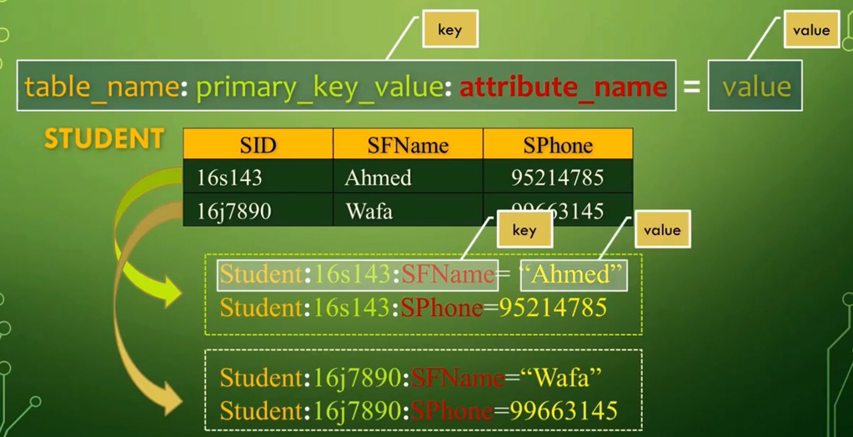
Key-value database

Slide 52
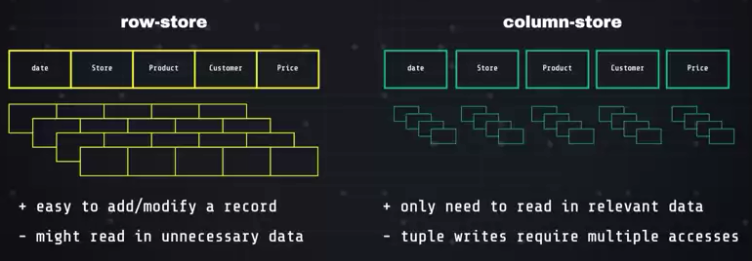
Column-oriented databases
They store the data in columns instead of rows
All attributes of a single entity are stored so that each of them can be accessed as a unit.
Column-oriented databases are not good for queries that require to present the whole record of an entity, in such cases the row store is better
Best Example of Row-oriented data stores is Relational Database, which is a structured data storage and also a sophisticated query engine.
It suffers a big drawback to improve performance as the data size increases.

Slide 53
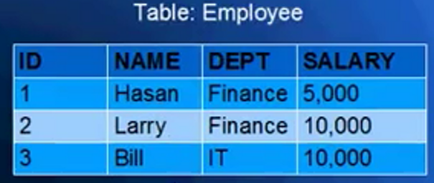
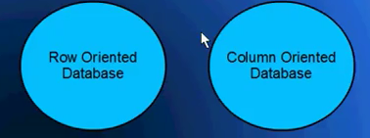
Database Storage orientation methods
This table is logical view (how database is storing this information is not visible to us: how the table is stored in the backend could be very different than what you see on the screen)
It stores 4 attributes of employee entity namely ID, Name, Dept. and Salary

Slide 54
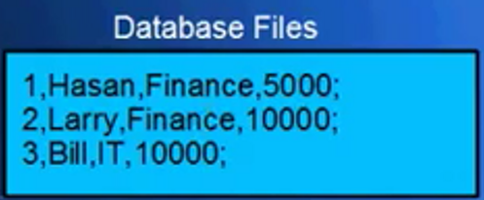
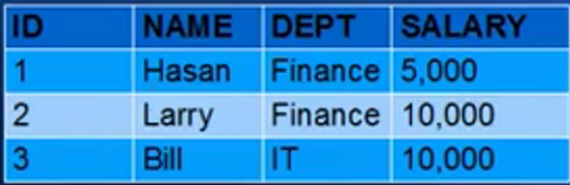
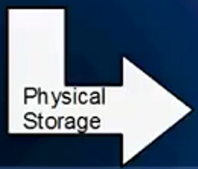
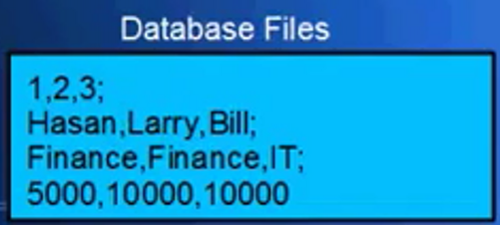
Database Storage orientation…Row vs column
In RowOriented
In ColumnOriented

Slide 55
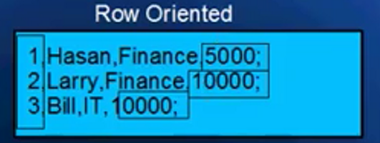
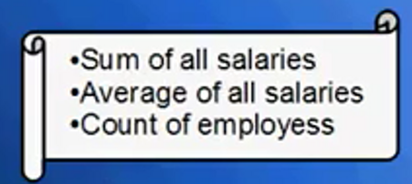
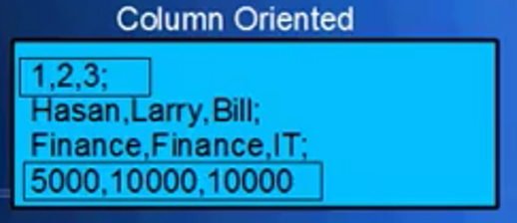
Advantages of column oriented in certain queries than row oriented
To answer the same query above the row oriented does 3 read operations(which is costly and takes time) while the column oriented does 1 read only

Slide 56
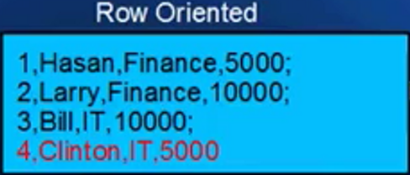
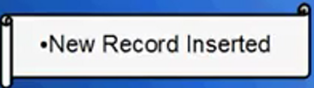
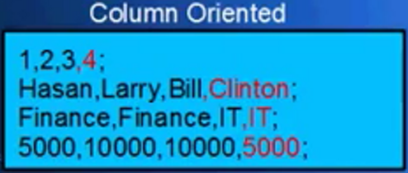
Advantages of row oriented in certain Queries than column oriented
These two tables above show the backend structure files not the tables.
In row oriented, system has to insert 1 row in the database.
While in the column oriented databases system has to update each of the four rows because values are getting upended at the end of each row.

Slide 57
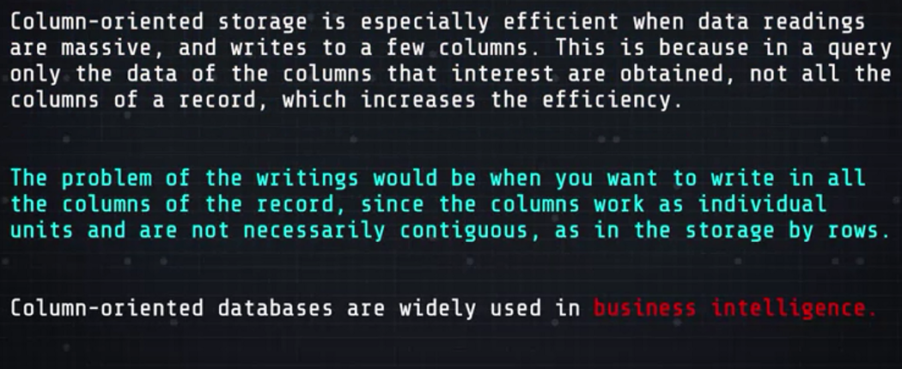
Column-oriented database
Examples of column oriented databases are :MariaDB, CrateDB, ClickHouse, Greenplum Database, Apache Hbase, Apache Kudu, Apache Parquet, Hypertable, MonetDB,SAP HANA.

Slide 58
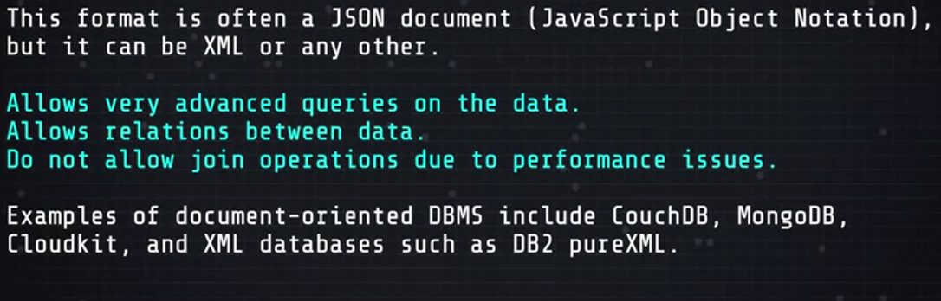
Document-oriented databases

Slide 59
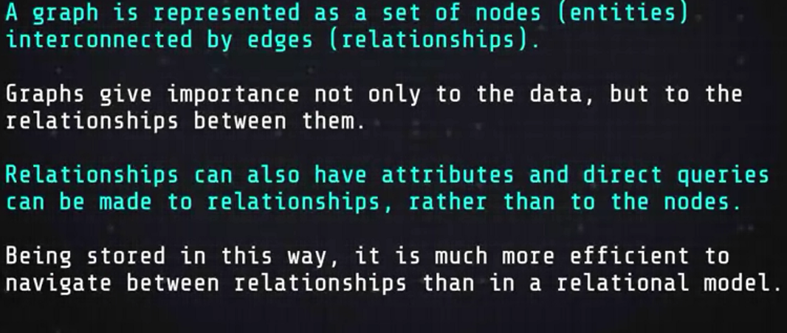
Graph-oriented databases
Examples of graph-oriented databases are Neo4j, infoGrid, Hyperbase-DB

Slide 60
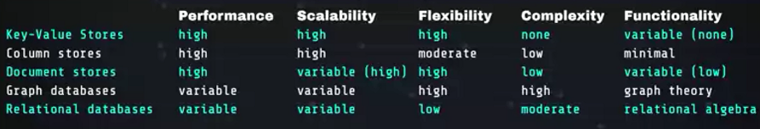
Which on to choose ?
Similarities and difference
All in One in the table below
MongoDB is the most popular NoSQL database.
A free and open source, cross-platform, document-oriented database
MongoDB uses JSON-like documents with schemas.

Slide 61
END of Slide!!!

